Slide 1

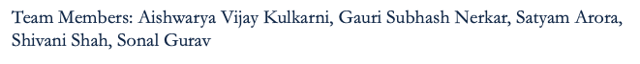
DAMG 6210
Team 5
SkyReserve: Airline Reservation Management System

Slide 2

CONTENTS
Purpose
Business Problems Solved
Business Rules
Entity Relationship Diagram
Database Implementation
Reporting & Visualization

Slide 3
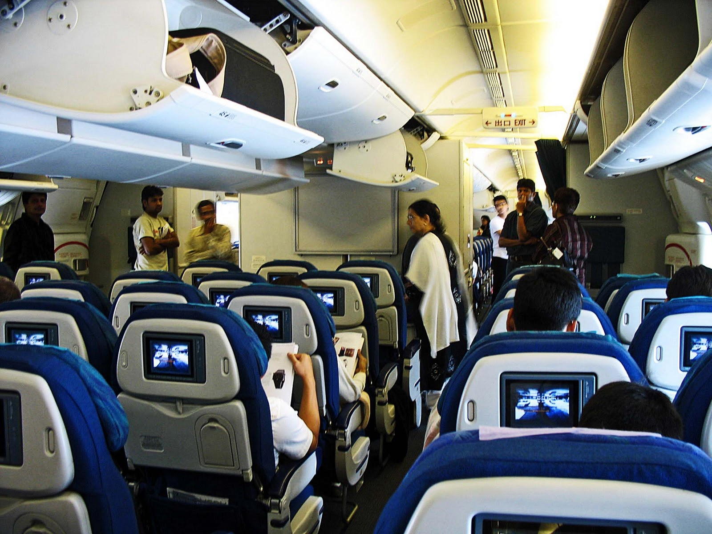
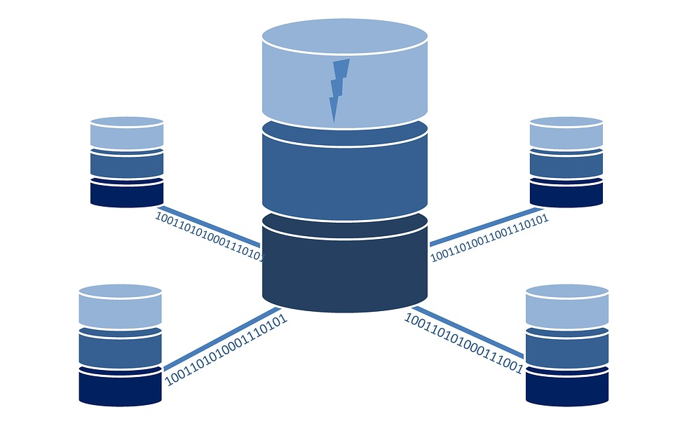
Purpose
The purpose of developing an Airline Reservation Management System is to create an efficient and centralized platform that automates and streamlines the process of managing airline reservations, ticketing, and related operations
It aims to enhance the overall booking experience for customers, optimize seat utilization, improve data management, and facilitate effective fare management

Slide 4



BUSINESS PROBLEM ADDRESSED
Student-focused benefits
Pricing and Fare Management
Paperless Booking Process
Efficient flight management
Customer satisfaction

Slide 5

BUSINESS RULES
A Passenger can have zero or more baggage/s
2. A Passenger can give zero or more feedback/s
6. An Airline will have one or many Flights
3. A Passenger may or may not be a student
7. A Flight can have zero or many Reservations
4. A Student can be part of only one Student Group Booking
8. An airport can have one or many Flights
5. A Student can have one or many students benefits
9. A Loyalty program will have one or more program benefits

Slide 6

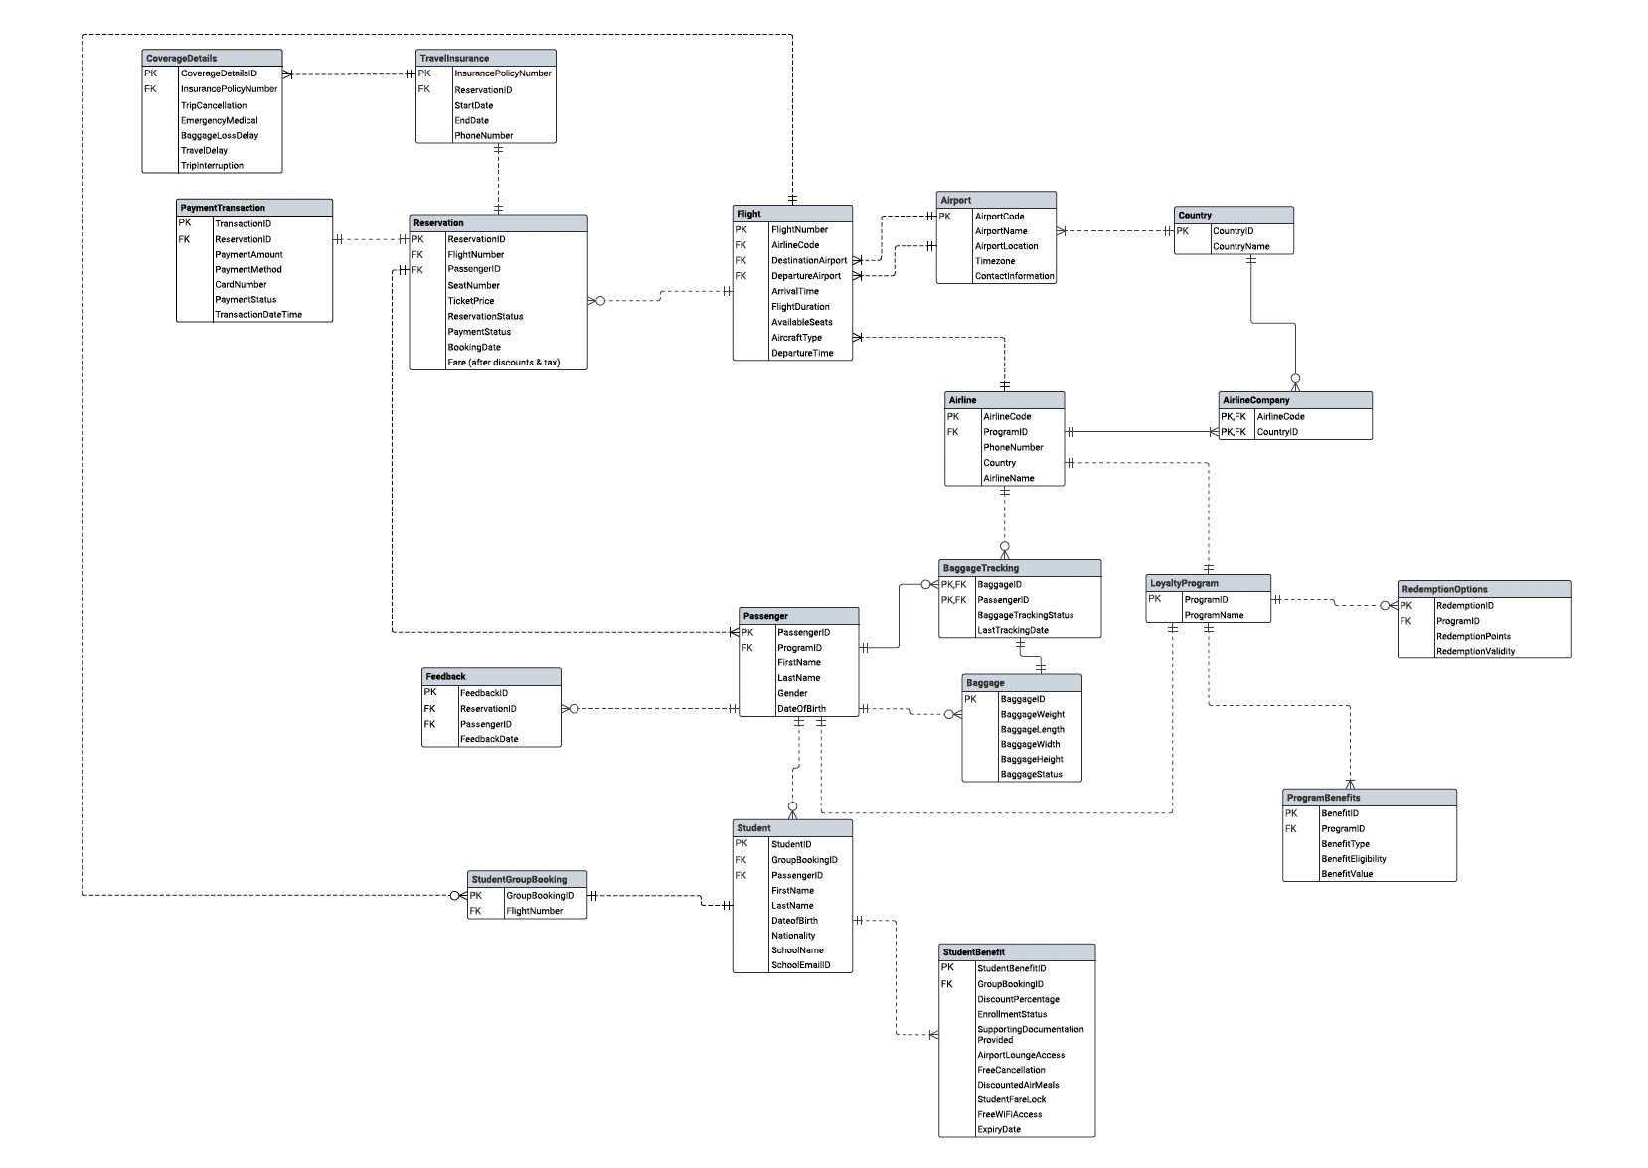
ENTITY RELATIONSHIP DIAGRAM
ENTITY RELATIONSHIP DIAGRAM

Slide 7







DATABASE IMPLEMENTATION
Tables
COMPUTED COLUMNS
3
8
ENCRYPTION
&
CONSTRAINTS
HOUSE
KEEPING
2
6
1
DATABASE
TRIGGERS
4
VIEWS
7
DATA
INSERT
5

Slide 8
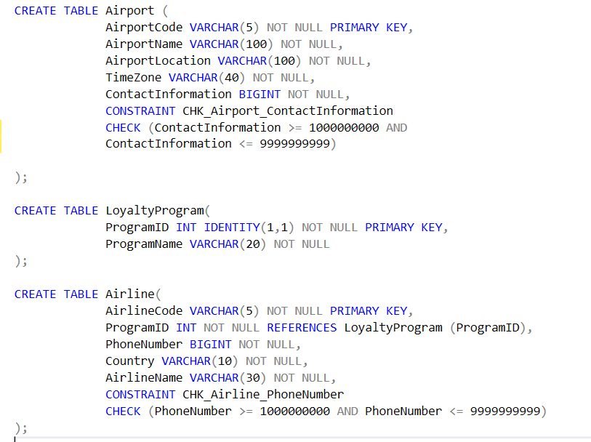
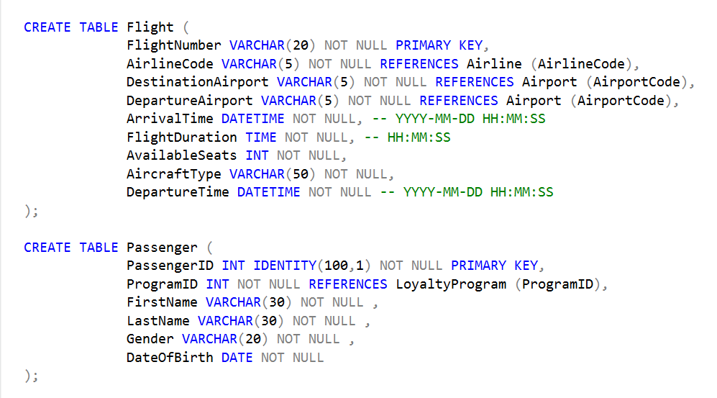
CREATE TABLES

Slide 9

1
Constraint to make sure baggage weight cannot exceed 50 lbs
CREATE FUNCTION CheckBaggageWeightLimit(@Weight INT) RETURNS BIT
AS BEGIN DECLARE @Result BIT;
IF @Weight <= 50 SET @Result = 1;
ELSE SET @Result = 0;
RETURN @Result; END;
CONSTRAINTS
2
Constraint on baggage table to limit baggage weight
ALTER TABLE Baggage ADD CONSTRAINT CheckBaggageWeight CHECK(dbo.CheckBaggageWeightLimit(BaggageWeight) = 1);
3
Constraint to make sure that supporting documents have been provided by students before making student reservation to get student benefits
CREATE FUNCTION CheckStudentSupportingDocument(@SupportingDocuments BIT)
RETURNS BIT AS BEGIN
DECLARE @Result BIT;
IF @SupportingDocuments = 1 SET @Result = 1
ELSE SET @Result = 0
RETURN @Result; END;
4
Constraint on student benefit table to make sure that supporting documents are provided
ALER TABLE StudentBenefit ADD CONSTRAINT CheckSupportingDocuments
CHECK (dbo.CheckStudentSupportingDocument(SupportingDocumentationProvided) = 1);

Slide 10
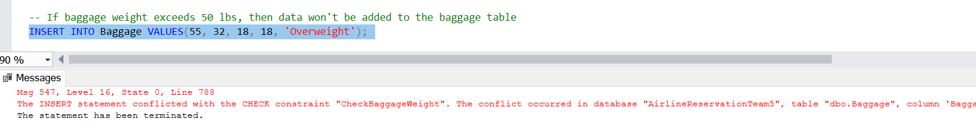
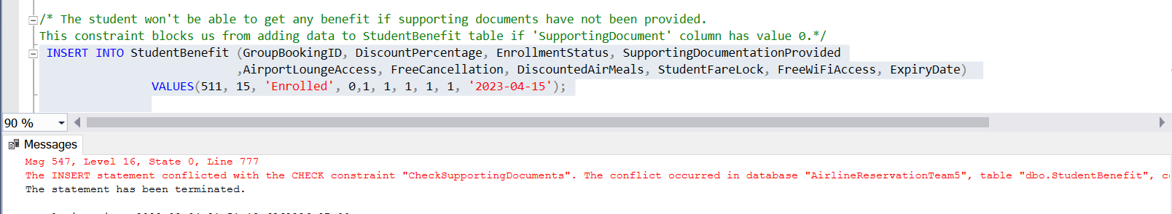
Constraints Output

Slide 11

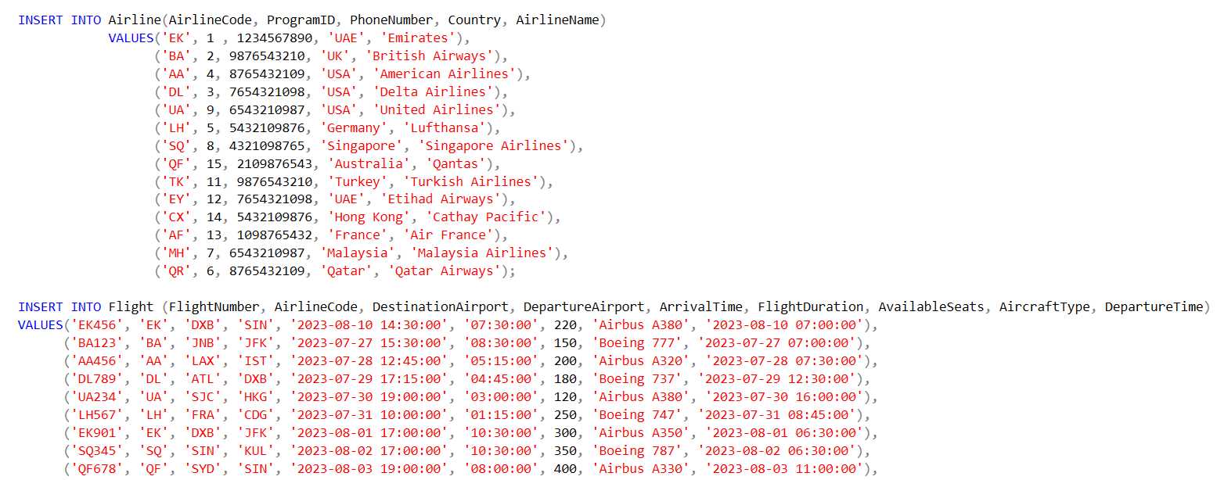
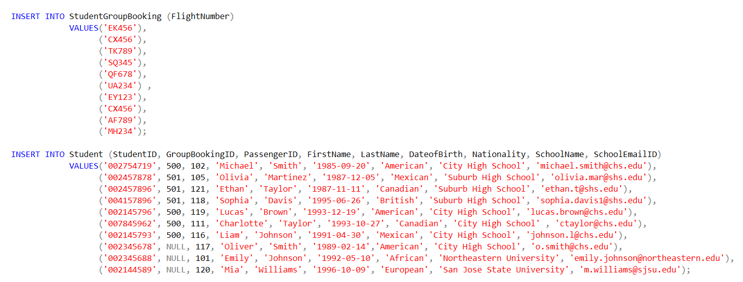
INSERTING DATA

Slide 12
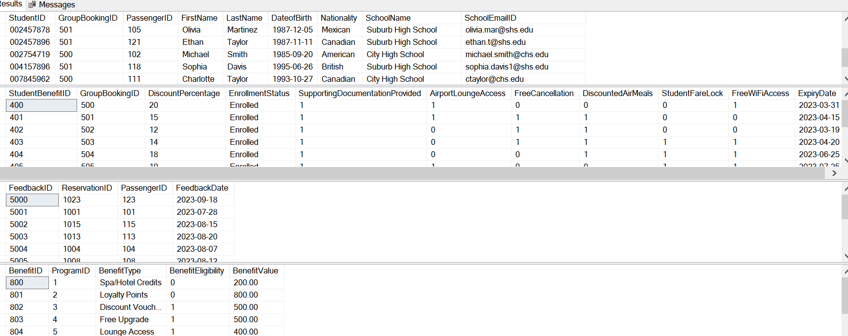
Results

Slide 13
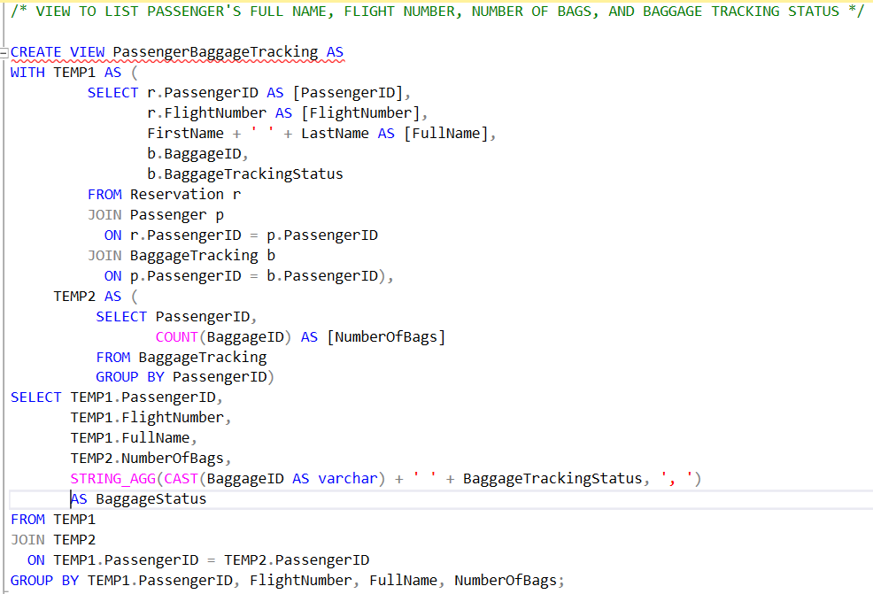
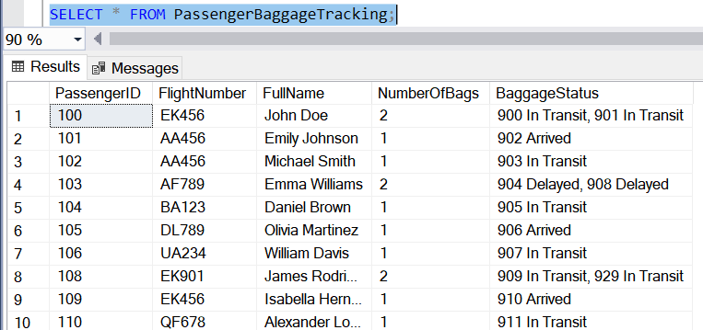
Views
VIEWS

Slide 14
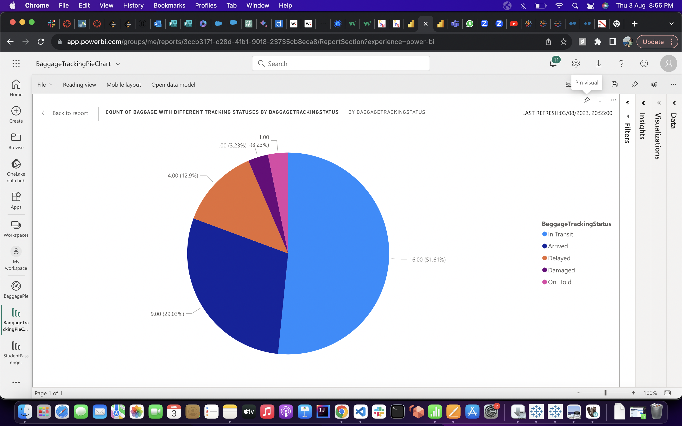
Count of Baggage with Different Tracking Status​ ​
Each segment of the Pie chart represents a specific tracking status, and the size of the segment corresponds to the number of bags with that status.
This data helps us assess baggage handling efficiency and identify areas for improvement.

Slide 15
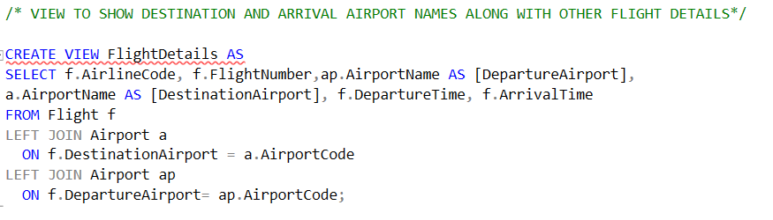
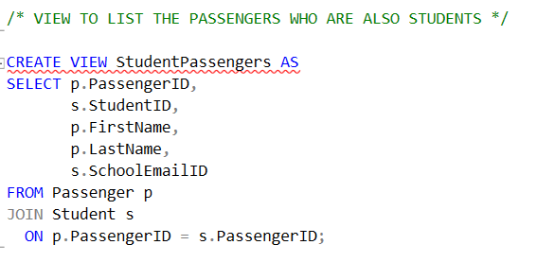
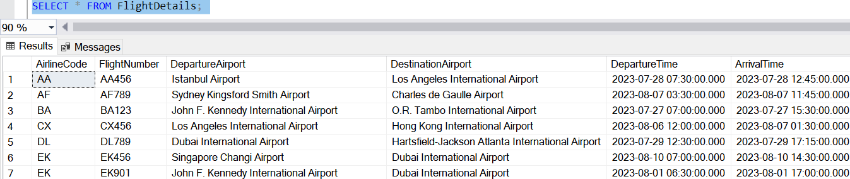
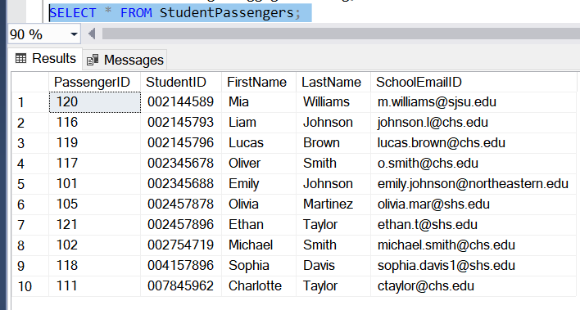
Views
VIEWS

Slide 16
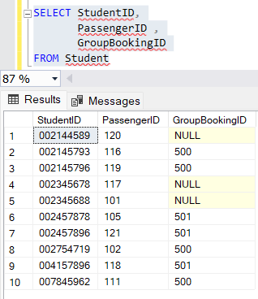
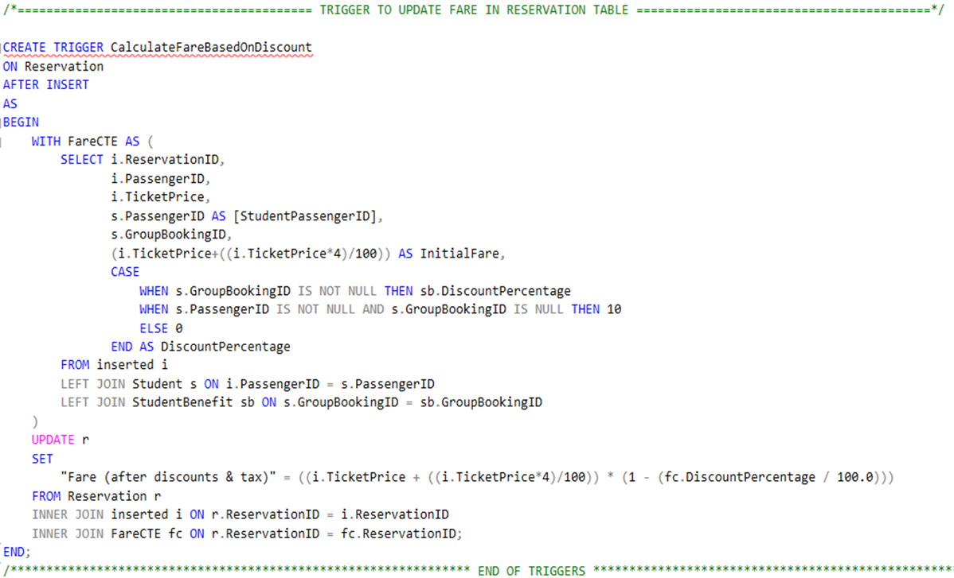
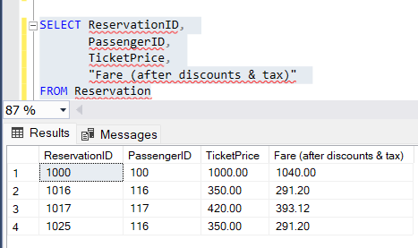
TRIGGERS
TRIGGERS

Slide 17
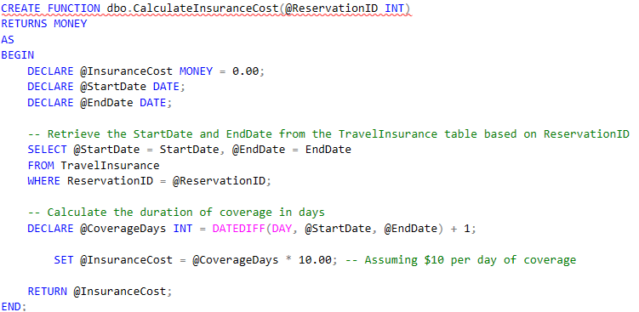
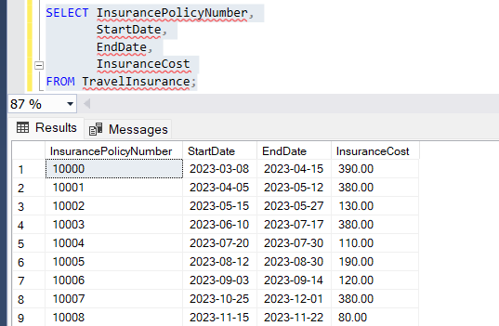
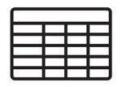
FUNCTION TO GENERATE COMPUTED COLUMN

Slide 18
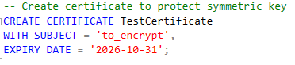
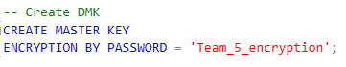
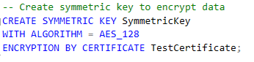
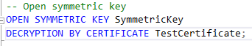

ENCRYPTION MASTER CODE
2
Create Certificate to protect symmetric key
1
Create DMK
3
Create Symmetric key to encrypt data
4
Open Symmetric key
This Photo by Unknown author is licensed under CC BY.

Slide 19
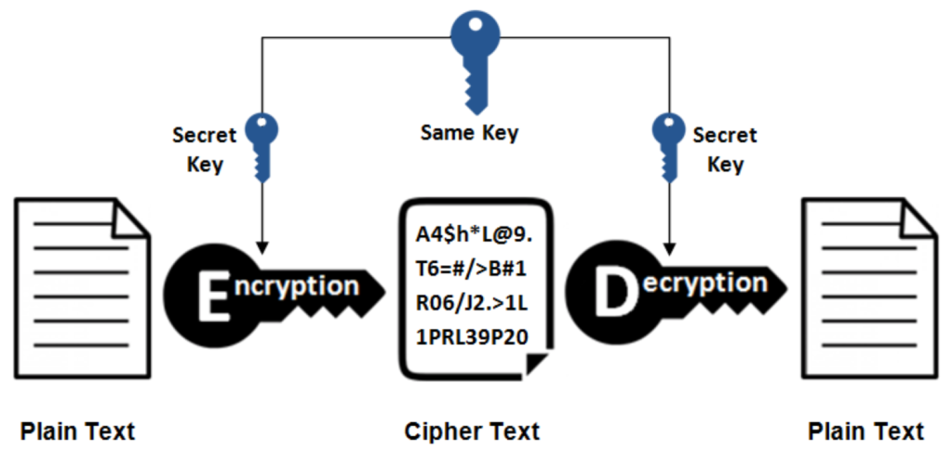
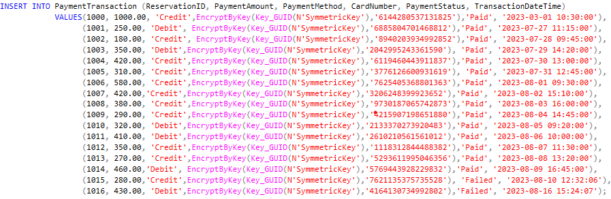
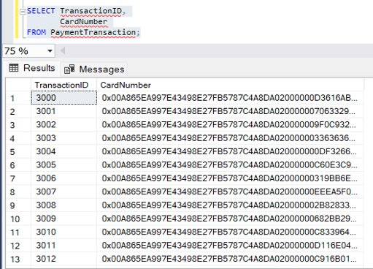

Slide 20
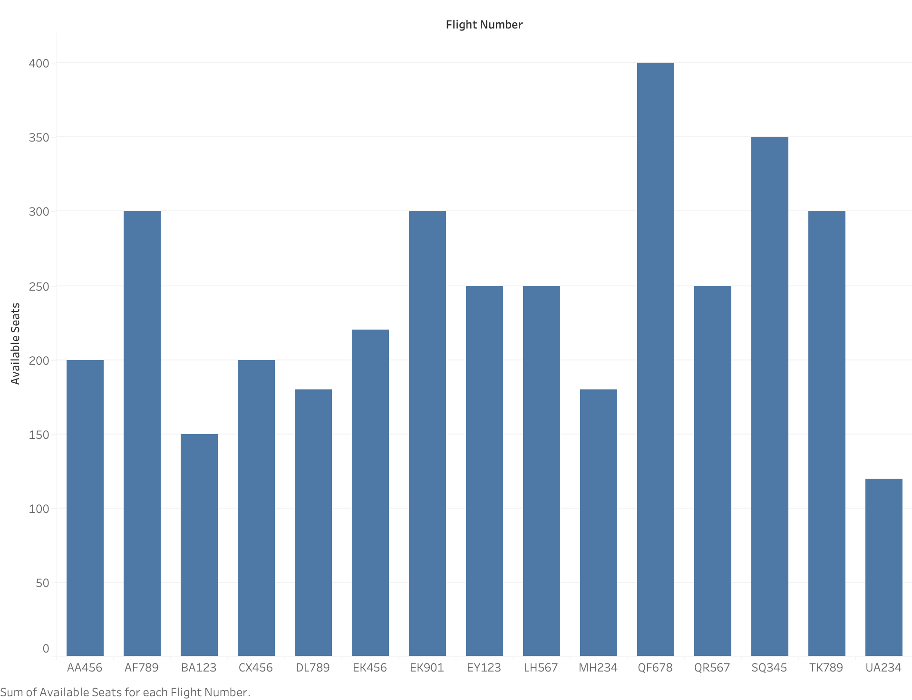
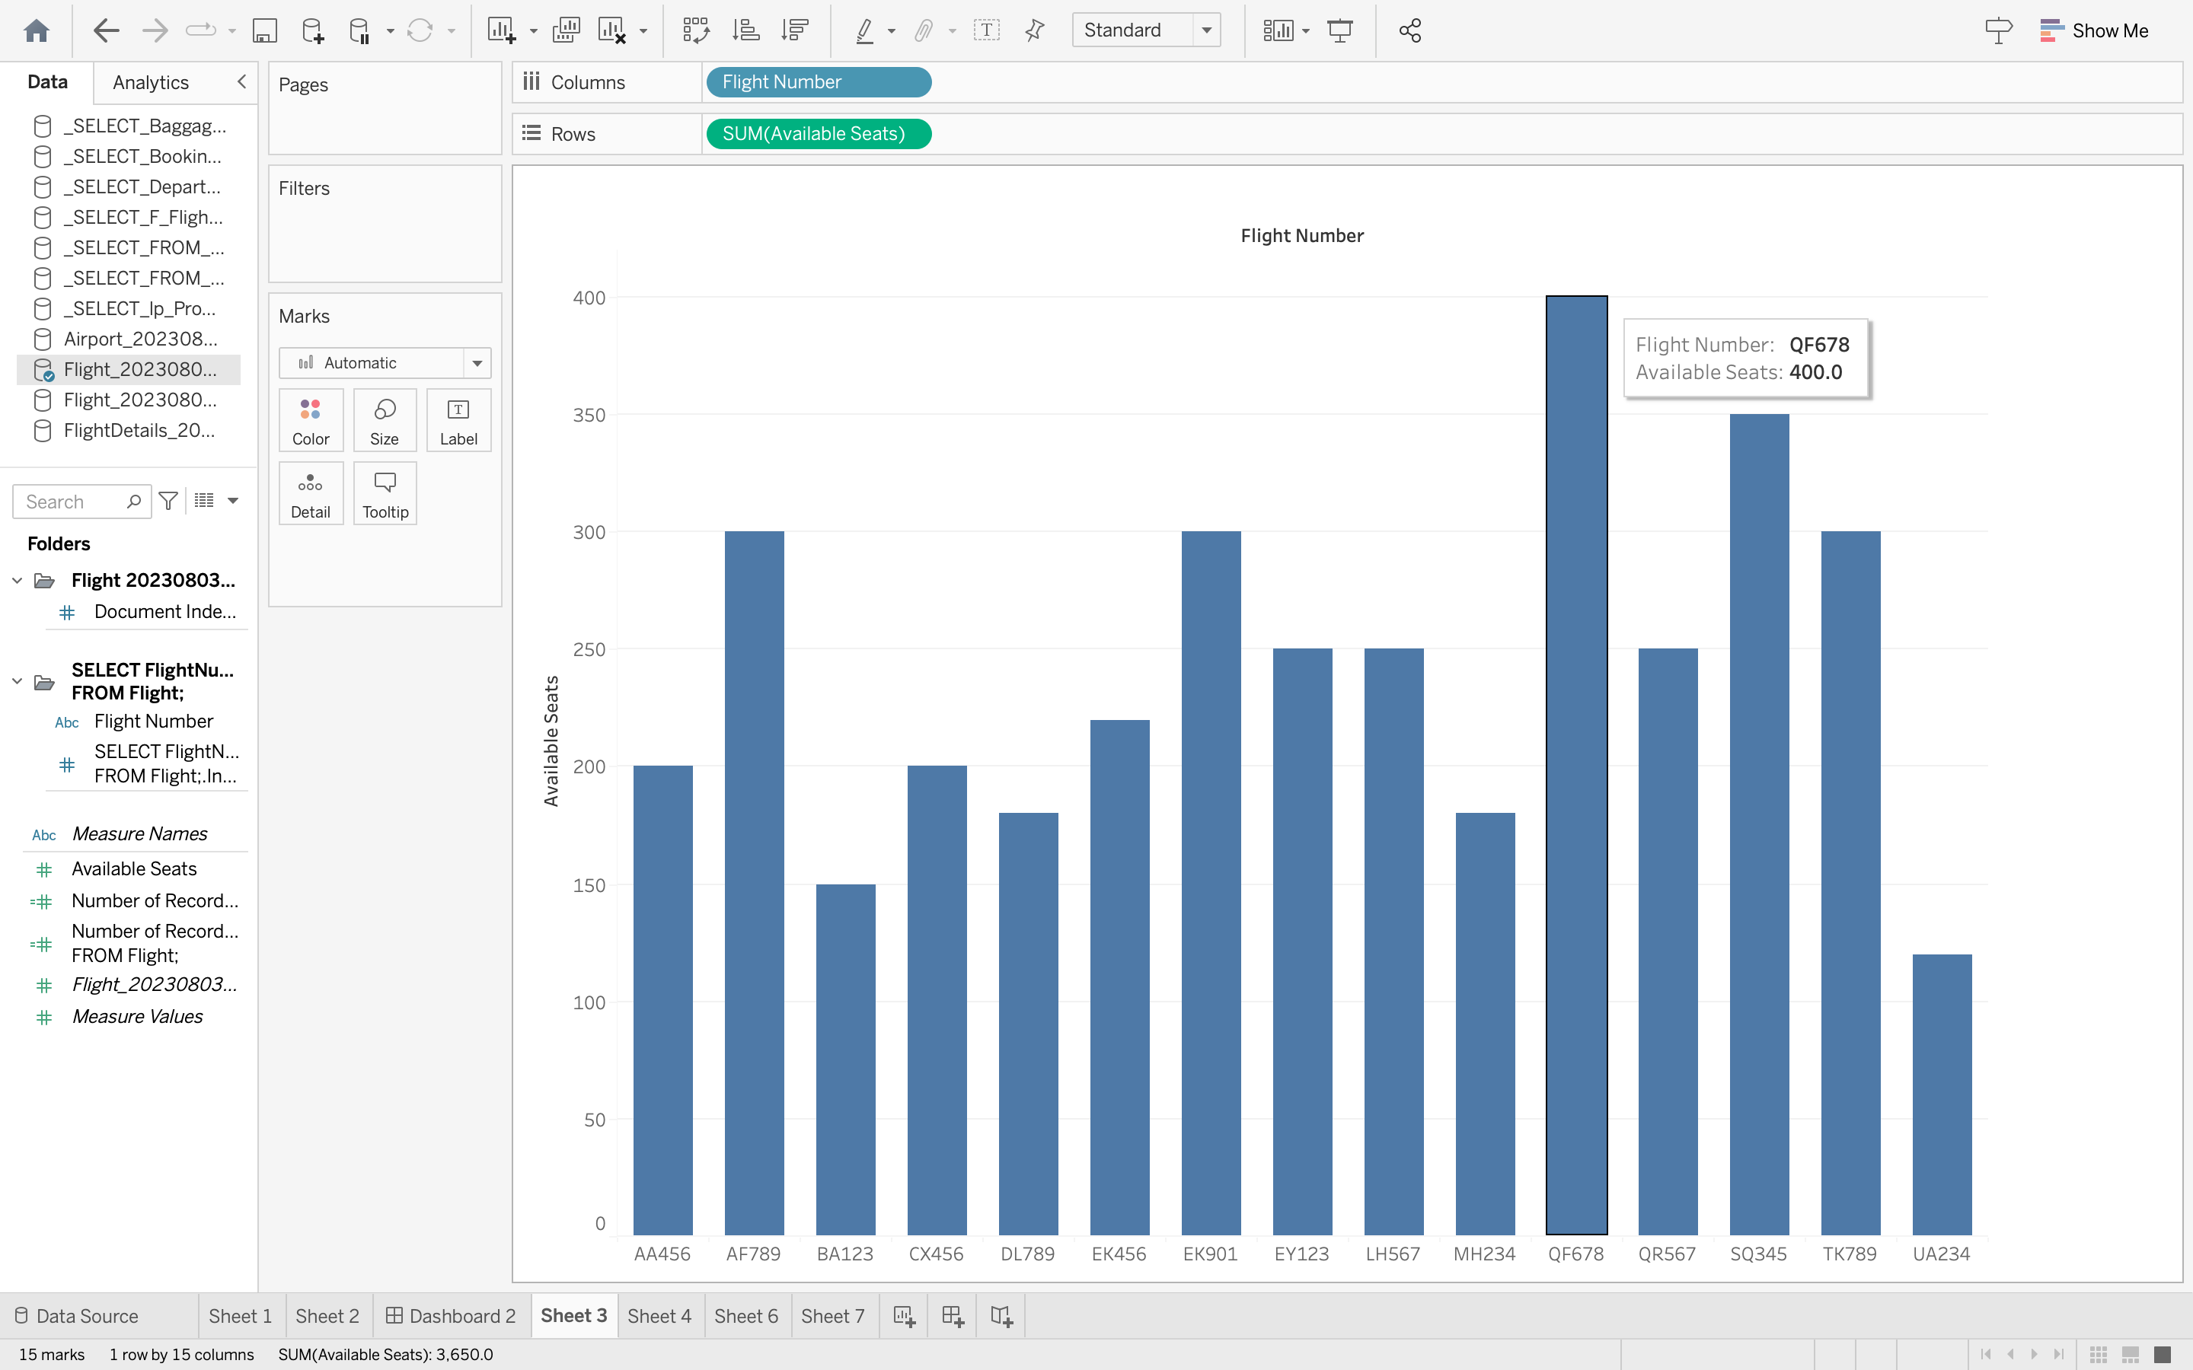
Visualization - Number of Available Seats for Each Flight
The bar chart showcases the number of available seats for each flight in our dataset.
Each bar represents a specific flight, and the height indicates the number of seats available on that flight.

Slide 21
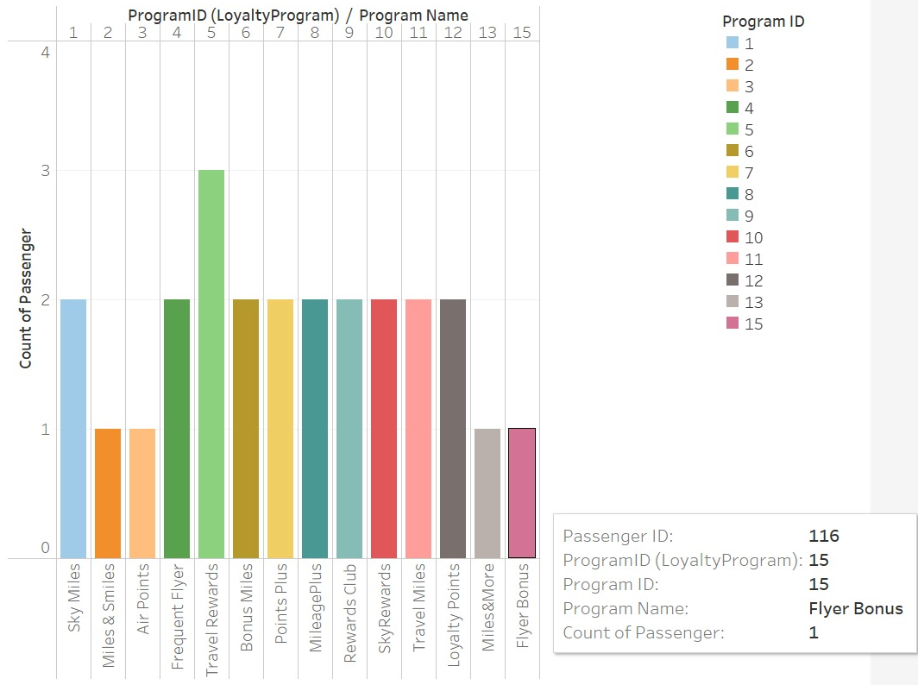
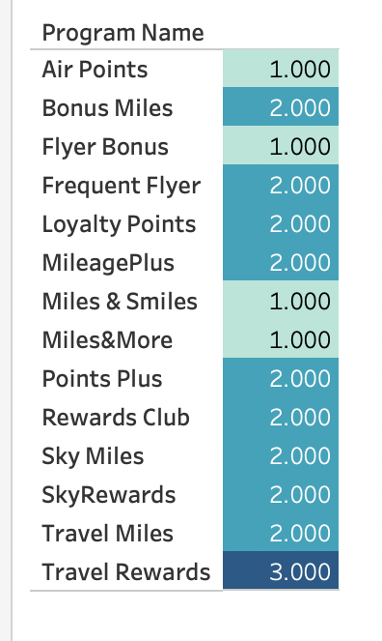
Loyalty Program Analysis -Distribution of passengers among different loyalty programs.
The visualization highlights the distribution of members across different loyalty programs, helping businesses make data-driven decisions to enhance customer engagement and satisfaction.
The data is based on a query that joins the 'LoyaltyProgram' table with the 'Passenger' table, grouping the results by program name.
Passengers

Slide 22
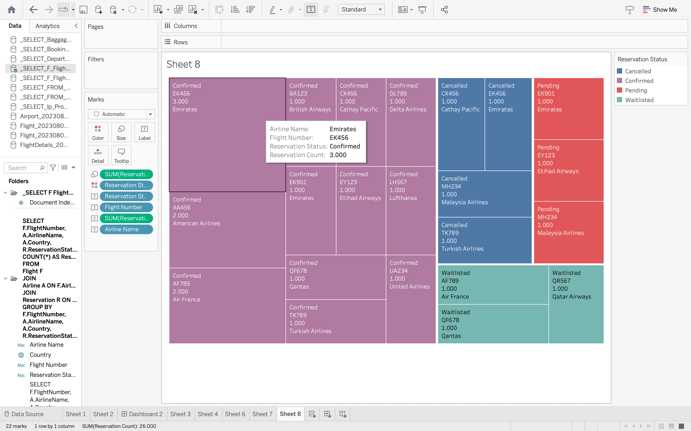
Flight-wise Reservation Status
Most flights have a higher number of reservations with 'Confirmed' status, while 'Pending' and 'Cancelled' reservations are relatively lower across all airlines."
Understanding reservation statuses helps optimize airline operations and improve customer experience

Slide 23
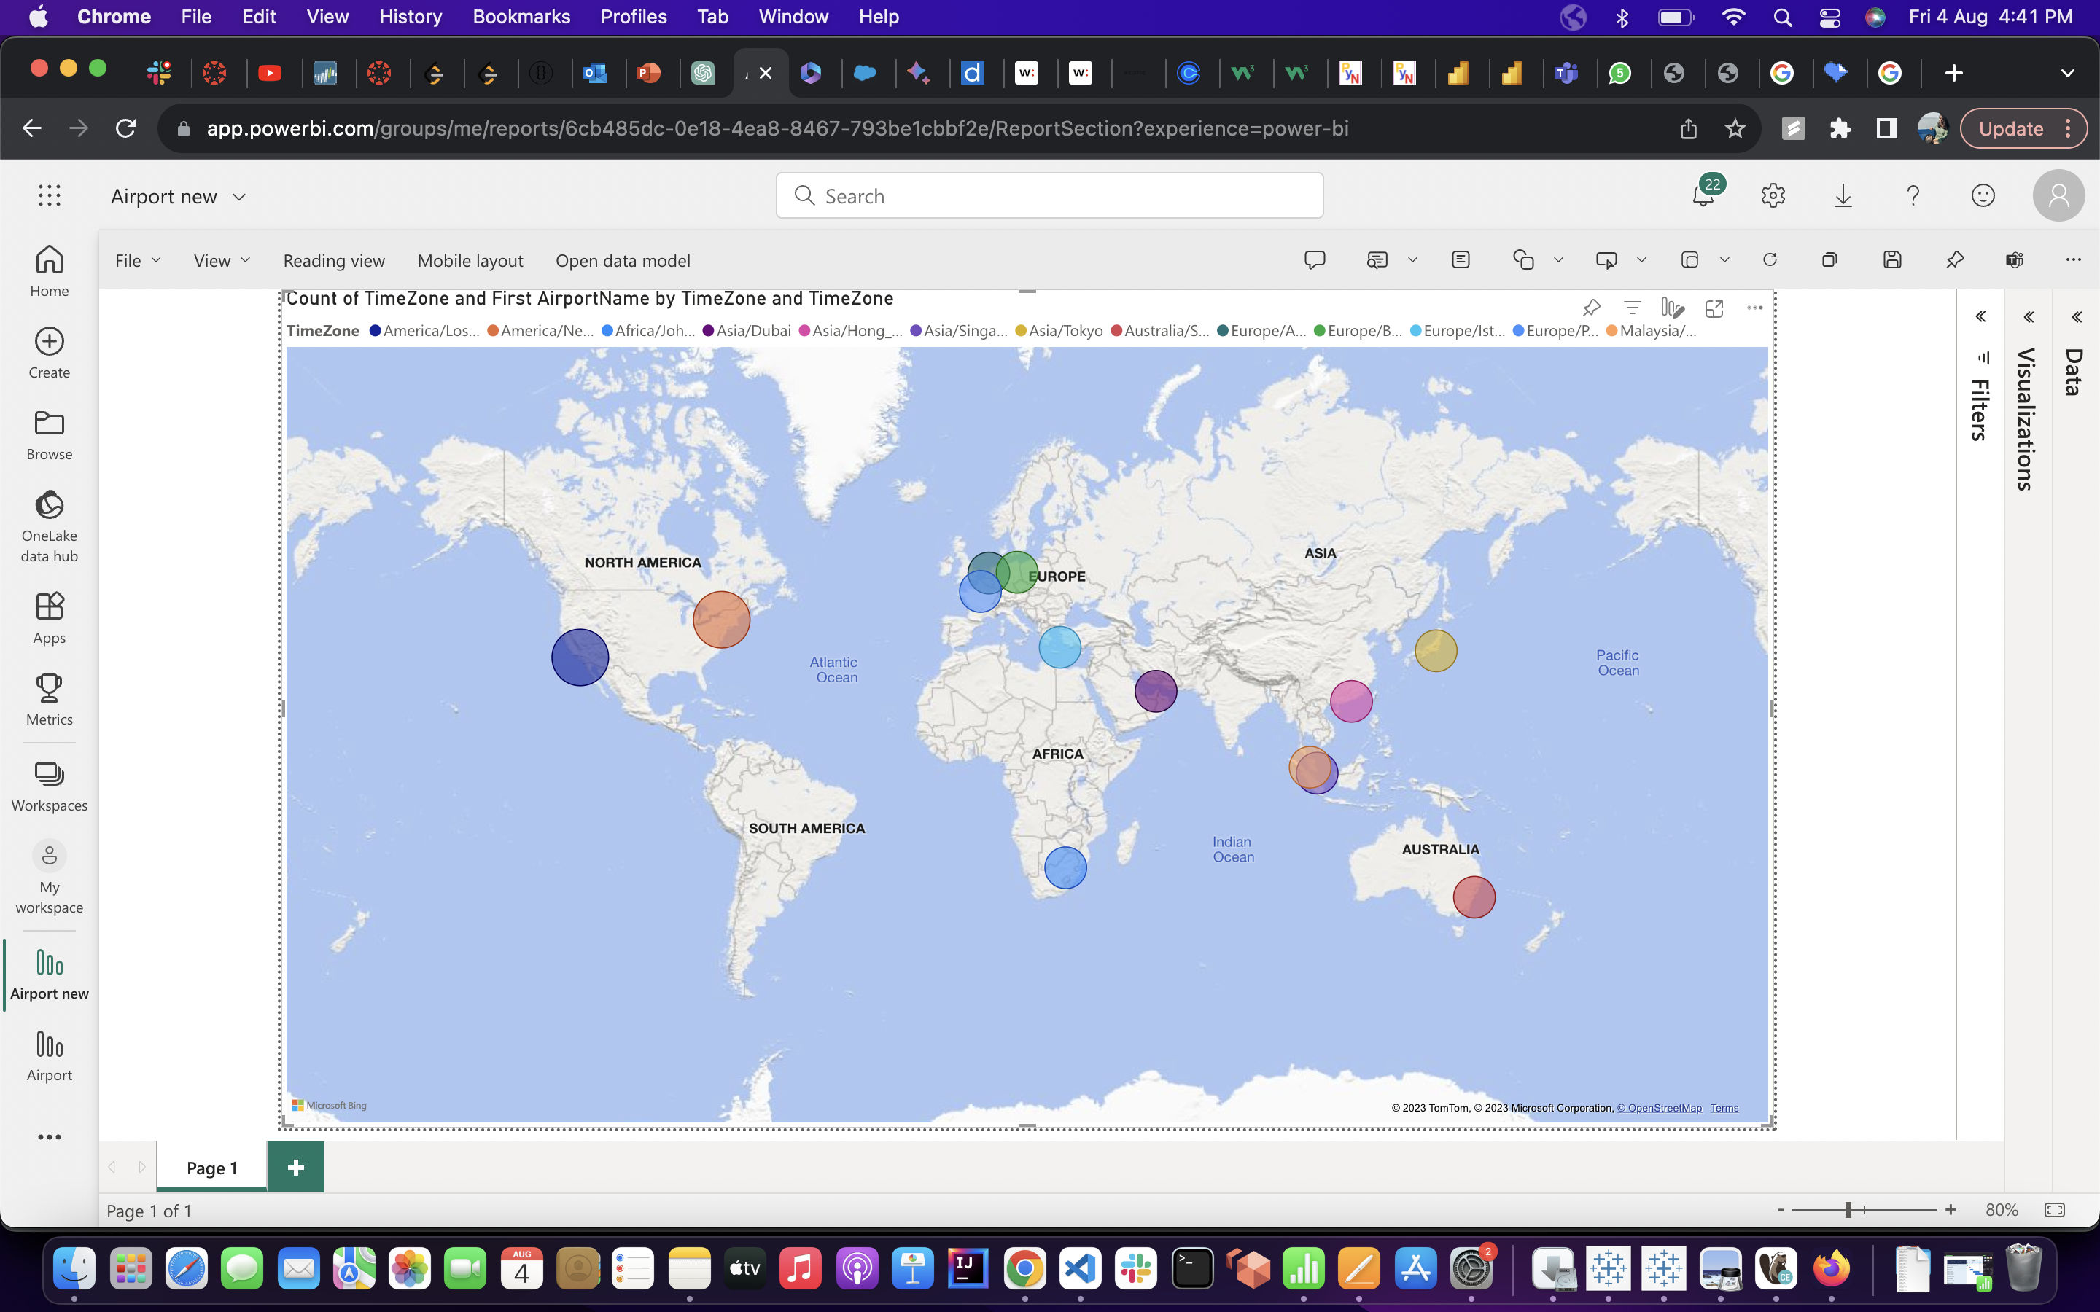
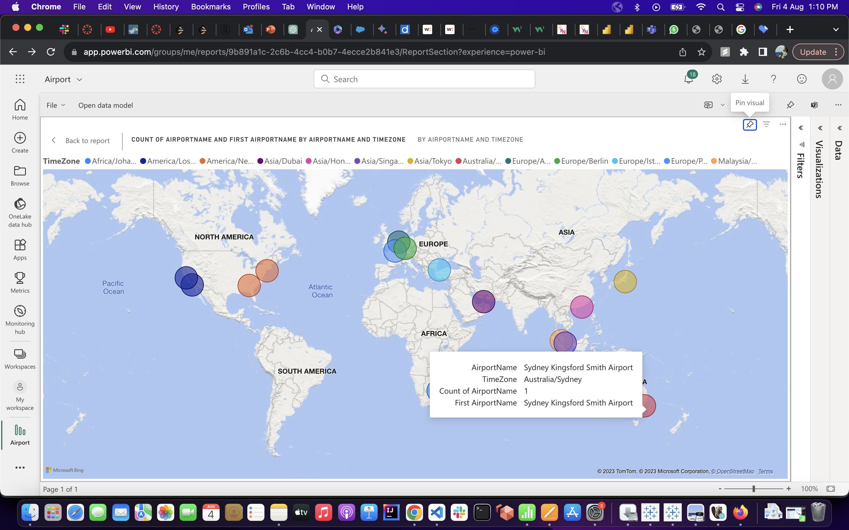
Airport Distribution by Time Zone

Slide 24

Thank You

Slide 25


